Slide 1
Credit Card Fraud Detection
THE POLICE
Cem Akagündüz
Hasan Can Buruk
Göktuğ Övren
Mehmet Akif Tür

Slide 2
Introduction
The dataset contains transactions made by credit cards in September 2013 by european cardholders and is taken by kaggle.
Properties of Data
492 fraud and 284,807 total transactions.
31 features, 28 of which have been anonymized with PCA and labeled V1 to V28.
No missing values.
Known features are time, amount, and class(Fraud=1, Non-fraud=0).
Notes:
H

Slide 3
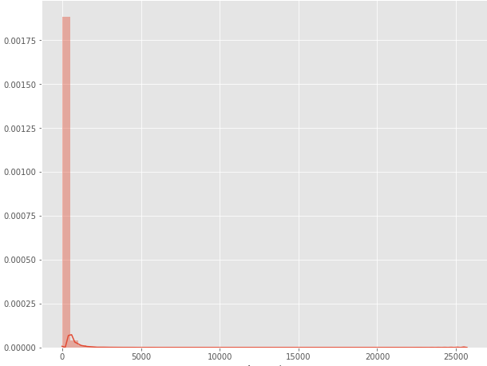
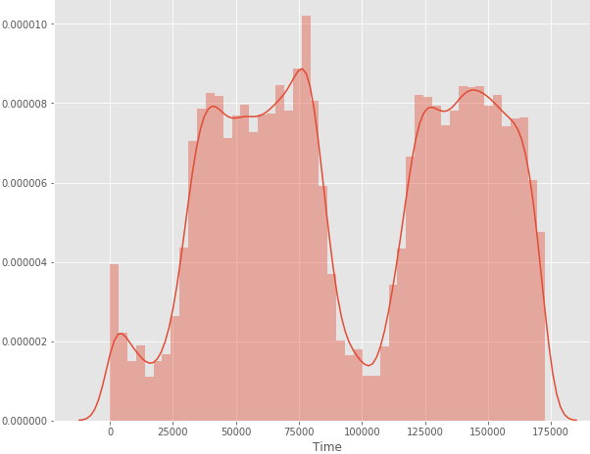
Data Analysis
amount
Time
Max:25691
Mean:88.35
Heavily right-skewed
In terms of second
Low transaction frequency during the night.

Slide 4
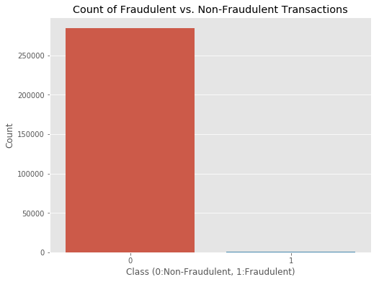
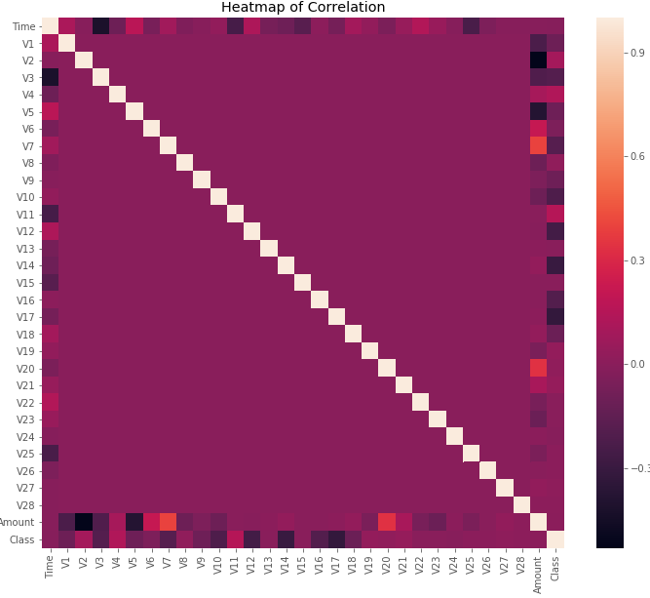
Data Analysis
CLASS
Correlatıon
0=Non-Fraudulent, 1=Fraudulent
Only 0.17% of transactions are fraudulent.
Little correlations because of huge class imbalance

Slide 5
Pre-Processing
Standardization
We standardized “time” and “amount” columns to get better results in KNN and LR.
imbalanced data problem
Since over 99% of our transactions are non-fraudulent, an algorithm that always predicts that the transaction is non-fraudulent would achieve an accuracy higher than 99%. However, it would give high False-Negative error.
Therefore, we got a subsample that has same amount of fraudulent and non-fraudulent transactions.
removing outliers
Since our data is small and has a lot of outliers, we only removed “extreme” outliers.

Slide 6
In third process, we will make predictions with ML Algorithms
First, We will use t-SNE Algorithm which makes Clustering. By means of t-SNE, We can extract dimensionally reduced 2 features and learn how difficult to handle our task.
When we look at our graph, we will see there are two features which are almost distinct with each other.
Therefore, our classification algorithms will probably show higher performances.

Slide 7
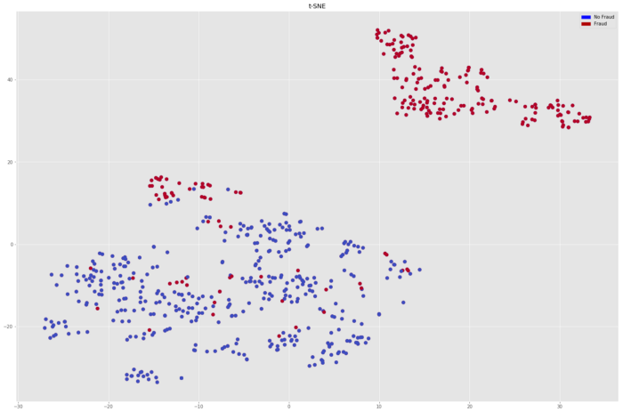
t-SNE Visualization

Slide 8
Classification Process
We will make a classification.
In first step, we will use basic machine learning algorithms
In second step, we will use pure ensemble machinelearning algrithms
In third step, we will use basic and pure ensemble machine learning algorithms with model selection techniques
In last , we will use a majority classifier, which sums all decisions from algorithms we use . Then they decide.

Slide 9
Experiments
In first step, logistic regression are more succesfull.
In second step, random forest showed a good performance but behind logistic regression with a little differences.
In third step, logistic regression with k-cv and svm with k-cv showed good performances and random forest with k-cv remained behind just a little bit.
In fourth step, we used majority classifier but it remains behind them.
Normally, lr with k-cv or svm with k-cv should be selected since rf with k-cv remained a little bit behind.
But rf algorithms can be visualized better and showed good cause and reason structure, we think that we should use it for a business strategy.

Slide 10
